Slide 1
Micro-Course on AI for Medical Image Classification
Edwin Arkel Rios

Slide 2
Previous Course Structure
Principles and Diagnosis Overview: 1 hour
Computer Vision Introduction, CNNs, Interpretability: 45 minutes
Data Preprocessing: 2 hours
Image Classification Colab Tutorial (3 types: AD, ASD, ICH): 50 minutes
Results Interpretation and Reasoning: 30 minutes
Group project presentations: 2 hours
Deep Learning Applications in Neuroimaging
Notes:
Alzheimers Disease
Autism Spectrum Disorder
IntraCeberal Hemorrhage

Slide 3
New Course Structure
Principles and Diagnosis Overview: 1 hour
Data preprocessing: 2 hours
Focus on how to preprocess with Python to make into Pytorch dataloader
Explain two examples: MRI and Histo
Data preprocessing lab: give each team a dataset and prepare a pytorch dataloader (will use later for group project)
Computer Vision with Deep Learning Introduction: 1 hour
Image Classification Colab Tutorial: 1 hour
Results Interpretation and Reasoning: 30 minutes
Group project presentations: 2 hours
Deep Learning Applications in Neuroimaging
Notes:
Alzheimers Disease
Autism Spectrum Disorder
IntraCeberal Hemorrhage

Slide 4
Medical Datasets
Name | Classes | Num. Train | Num. Test | Task | Type | Year
ABIDE I | 2 | 1102 | ? | Classification | MRI | 2016
Guangzhou Chest X-Ray | 2/3 | 5232 | 624 | Classification | X-Ray | 2018
Bangladesh CT Kidney | 4 | 12466 |  | Classification | CT | 2022
IDRID | 5/3/8 | 413 | 103 | Classification | Retinal Image | 2018
MHIST | 2 | 2175 | 977 | Classification | Histopathology | 2021
Notes:
Autism Brain Imaging Data Exchange I ABIDE I
https://fcon_1000.projects.nitrc.org/indi/abide/abide_I.html

Slide 5

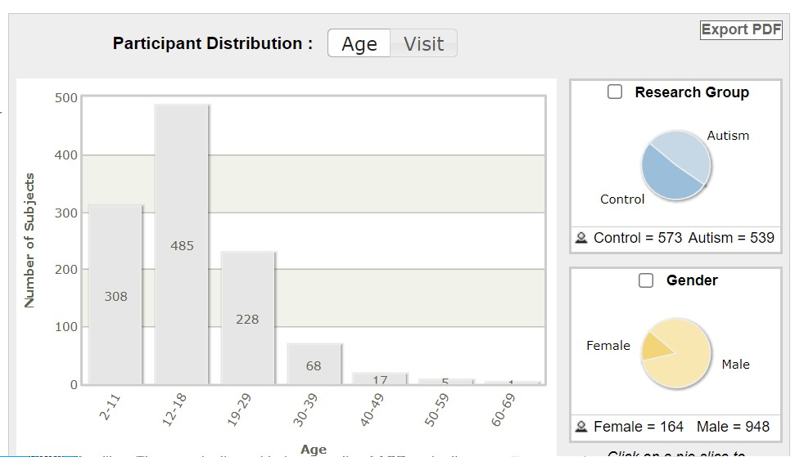
Autism Spectrum Disorder (ASD): ABIDE I
Total of 1102 participants, 531 individuals with ASD and 571 typical developmental controls
Resting state functional magnetic resonance imaging (rs-fMRI): 3D data with 1 channel
3.55 GB
https://fcon_1000.projects.nitrc.org/indi/abide/abide_I.html
Notes:
wget -O ASDDataset.zip https://huggingface.co/datasets/NYCU-PCSxNTHU-MIS/ABIDEI/resolve/main/ASDDataset.zip?download=true
https://huggingface.co/datasets/NYCU-PCSxNTHU-MIS/ABIDEI
Autism Brain Imaging Data Exchange I ABIDE I
https://fcon_1000.projects.nitrc.org/indi/abide/abide_I.html
Total of 1102 participants, 531 individuals with ASD and 571 typical developmental controls
ages 6-64 years, median 14.7 years old
Data adopting
Resting state functional magnetic resonance imaging (rs-fMRI)
Behavior data
The Autism Diagnostic Interview-Revised (ADI-R)
Autism Diagnostic Observation Schedule-2nd edition (ADOS-2)
Social Responsiveness Scale, 2nd Edition (SRS-2)
The Vineland Adaptive Behavior Scales (VABS) (Vineland-3)
Wechsler Intelligence Scale for Children (WISC IV)

Slide 6
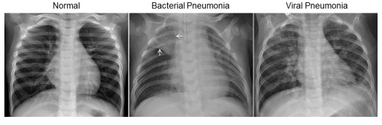
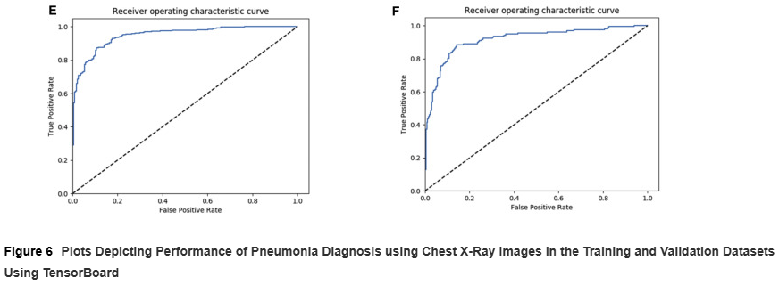
X-Ray: Guangzhou Chest X-Ray (GZCXRay)
5,856 chest X-ray images
2 classes: normal and pneumonia
3 classes: normal, bacterial pneumonia, virus pneumonia (in file names)
Naming: (disease:NORMAL/BACTERIA/VIRUS)-(randomized patient ID)-(image number of a patient)
Split into train and test
5232 for train and 624 for test
1.27 GB (out of 6.55 GB/7.85 GB)
https://data.mendeley.com/datasets/rscbjbr9sj/3
Notes:
wget -O OCTXRay.zip https://data.mendeley.com/public-files/datasets/rscbjbr9sj/files/810b2ce2-11c3-4424-996e-3bef36600907/file_downloaded
Version 3: one download only
https://data.mendeley.com/datasets/rscbjbr9sj/3
https://data.mendeley.com/public-files/datasets/rscbjbr9sj/files/810b2ce2-11c3-4424-996e-3bef36600907/file_downloaded
Version 2: provides separate downloads for OCT, ChestXray and code (6.55 GB in total)
https://data.mendeley.com/datasets/rscbjbr9sj/2
All data: X-ray and OCT
Xray:
https://data.mendeley.com/public-files/datasets/rscbjbr9sj/files/f12eaf6d-6023-432f-acc9-80c9d7393433/file_downloaded
OCT:
https://data.mendeley.com/public-files/datasets/rscbjbr9sj/files/5699a1d8-d1b6-45db-bb92-b61051445347/file_downloaded
Labeled Optical Coherence Tomography (OCT) and Chest X-Ray Images for Classification
Identifying Medical Diagnoses and Treatable Diseases by Image-Based Deep Learning
Deep learning-based classification and referral of treatable human diseases
Dataset of validated OCT and Chest X-Ray images described and analyzed in "Deep learning-based classification and referral of treatable human diseases". The OCT Images are split into a training set and a testing set of independent patients. OCT Images are labeled as (disease)-(randomized patient ID)-(image number by this patient) and split into 4 directories: CNV, DME, DRUSEN, and NORMAL.
https://www.kaggle.com/datasets/tolgadincer/labeled-chest-xray-images
We collected and labeled a total of 5,232 chest X-ray images from children, including 3,883 characterized as depicting pneumonia (2,538 bacterial and 1,345 viral) and 1,349 normal, from a total of 5,856 patients to train the AI system. The model was then tested with 234 normal images and 390 pneumonia images (242 bacterial and 148 viral) from 624 patients. After 100 epochs (iterations through the entire dataset) of the model, the training was stopped due to the absence of further improvement in both loss and accuracy (Figures 6A and 6B).
In the comparison of chest X-rays presenting as pneumonia versus normal, we achieved an accuracy of 92.8%, with a sensitivity of 93.2% and a specificity of 90.1%. The area under the ROC curve for detection of pneumonia from normal was 96.8% (Figure 6E). Binary comparison of bacterial and viral pneumonia resulted in a test accuracy of 90.7%, with a sensitivity of 88.6% and a specificity of 90.9% (Figures 6C and 6D). The area under the ROC curve for distinguishing bacterial and viral pneumonia was 94.0%
Optical coherence tomography (OCT) images (Spectralis OCT, Heidelberg Engineering, Germany) were selected from retrospective cohorts of adult patients from the Shiley Eye Institute of the University of California San Diego, the California Retinal Research Foundation, Medical Center Ophthalmology Associates, the Shanghai First People’s Hospital, and Beijing Tongren Eye Center between July 1, 2013 and March 1, 2017. All OCT imaging was performed as part of patients’ routine clinical care. There were no exclusion criteria based on age, gender, or race. We searched local electronic medical record databases for diagnoses of choroidal neovascularization, diabetic macular edema, drusen and normal to initially assign images. A horizontal foveal cut of OCT scans was downloaded with a standard image format according to manufacure’s softwares and instructions. Chest X-ray images (anterior-posterior) were selected from retrospective cohorts of pediatric patients of one to five years old from Guangzhou Women and Children’s Medical Center, Guangzhou. All chest X-ray imaging was performed as part of patients’ routine clinical care. Institutional Review Board (IRB)/Ethics Committee approvals were obtained. The work was conducted in a manner compliant with the United States Health Insurance Portability and Accountability Act (HIPAA) and was adherent to the tenets of the Declaration of Helsinki.

Slide 7
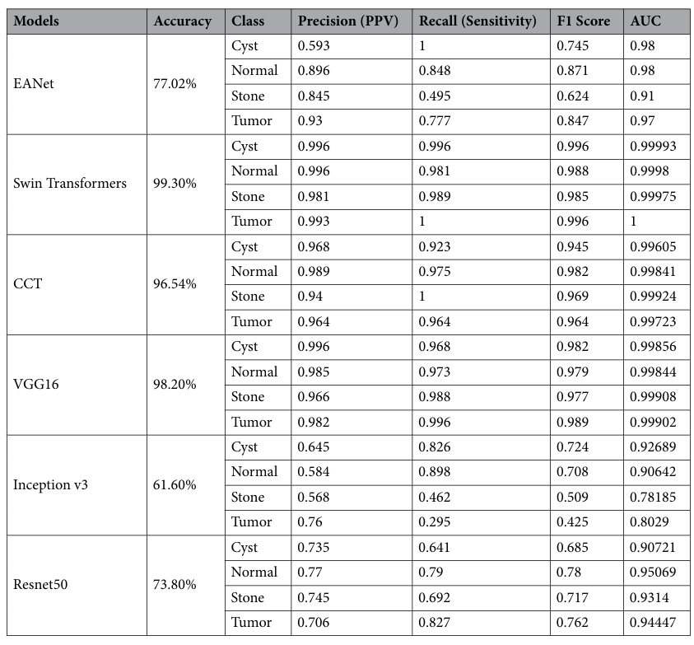
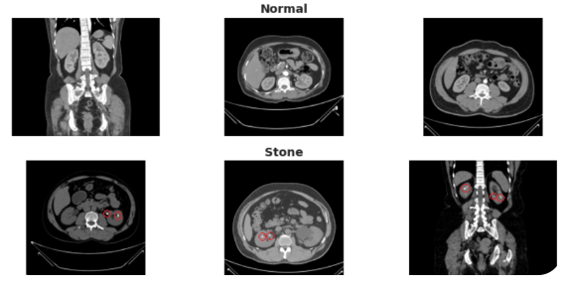
Computer Tomography (CT) Kidney: BDCTKidney
Normal-Cyst-Tumor and Stone
12,466 images from Bangladesh
4 classes: tumor, cyst, normal or stone
1.7 GB
https://www.kaggle.com/datasets/nazmul0087/ct-kidney-dataset-normal-cyst-tumor-and-stone
Notes:
kaggle datasets download nazmul0087/ct-kidney-dataset-normal-cyst-tumor-and-stone
5200 (randomly 1300 for each class, flexible)
7266
Our created dataset contains 12,446 unique data within it in which the cyst contains 3,709, normal 5,077, stone 1,377, and tumor 2,283
From the dataset, i. e., the CT KIDNEY DATASET: Normal-Cyst-Tumor and Stone, we randomly chose 1300 images of each class and trained our six models. All the neural network models were trained on Google Colab Pro Edition with 26.3 GB of GEN Ram and 16160 MB of GPU RAM using Cuda version 11.2. All the models were trained with a batch size of 16 and up to 100 epochs.
The dataset was collected from PACS (Picture archiving and communication system) from different hospitals in Dhaka, Bangladesh where patients were already diagnosed with having a kidney tumor, cyst, normal or stone findings. Both the Coronal and Axial cuts were selected from both contrast and non-contrast studies with protocol for the whole abdomen and urogram. The Dicom study was then carefully selected, one diagnosis at a time, and from those we created a batch of Dicom images of the region of interest for each radiological finding. Following that, we excluded each patient's information and meta data from the Dicom images and converted the Dicom images to a lossless jpg image format. After the conversion, each image finding was again verified by a radiologist and a medical technologist to reconfirm the correctness of the data.
Islam MN, Hasan M, Hossain M, Alam M, Rabiul G, Uddin MZ, Soylu A. Vision transformer and explainable transfer learning models for auto detection of kidney cyst, stone and tumor from CT-radiography. Scientific Reports. 2022 Jul 6;12(1):1-4.

Slide 8
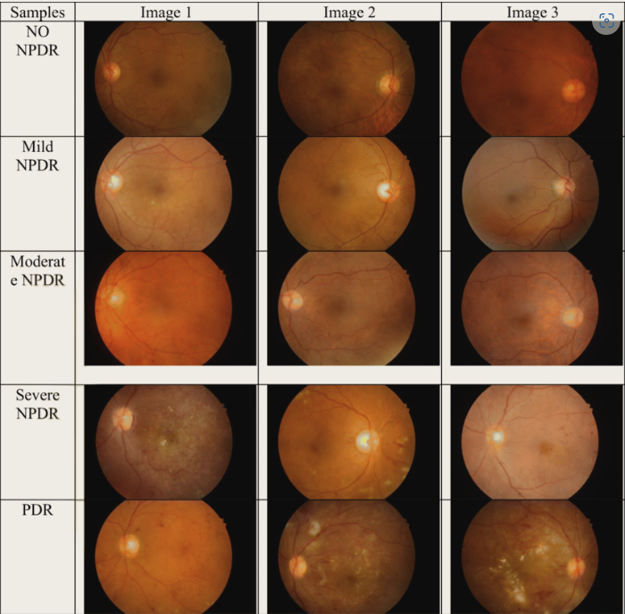
Diabetic Retinopathy: IDRID
516 images: 413 train and 103 test
Diabetic Retinopathy (DR): 5 levels and Diabetic Macular Edema (DME): 3 levels
187 MB
https://ieee-dataport.org/open-access/indian-diabetic-retinopathy-image-dataset-idrid
Notes:
wget -O IDRID.zip https://huggingface.co/datasets/NYCU-PCSxNTHU-MIS/IDRID/resolve/main/IDRID.zip?download=true
Indian Diabetic Retinopathy Image Dataset (IDRiD): A Database for Diabetic Retinopathy Screening Research
IDRiD: Diabetic Retinopathy – Segmentation and Grading Challenge
A novel diabetic retinopathy grading using modified deep neural network with segmentation of blood vessels and retinal abnormalities
187 MB

Slide 9
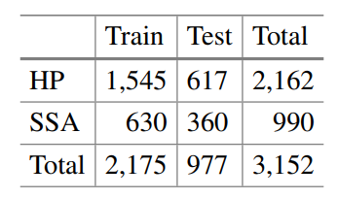
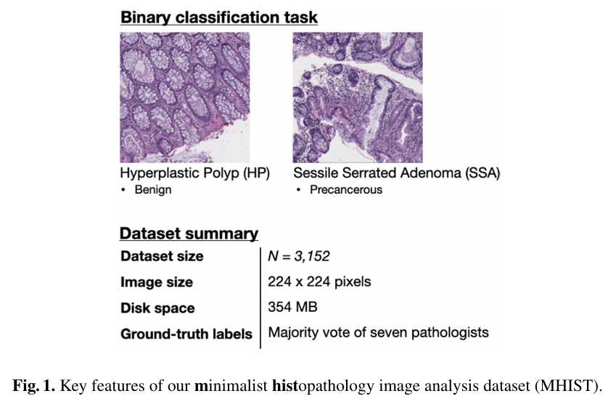
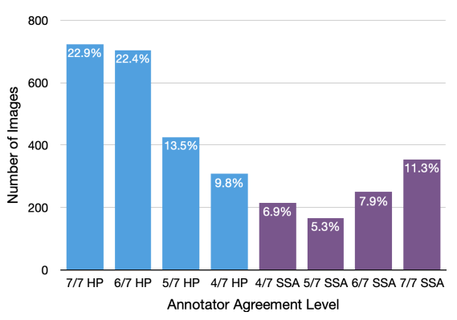
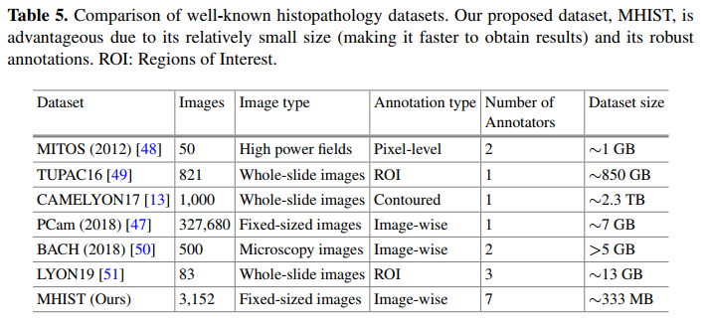
Colorectal Polyps: MHIST
3152 hematoxylin and eosin (H&E)-stained Formalin Fixed Parraffin-Embedded (FFPE) fixed-size images (224x224) of colorectal polyps
2,175 training and 977 testing
2 classes: Hyperplastic Polyp (HP, benign) and Sessile Serrated Adenoma (SSA, pre-cancer)
333 MB
https://bmirds.github.io/MHIST/
Notes:
wget -O MHIST_images.zip https://uc9493694fa8ba414fc8d2f54b81.dl.dropboxusercontent.com/cd/0/get/CkCEJNYmnyExb1sCDzhK6gIlCvge9jENN_SiTfmIO7-y2kqX6EPeQkUbGRogmYDXGI1Lj6FLtOhM5dzm4euosNDBAsBx3dyMeWKT400Ez80135n0ymK-ZHzTUg9QQ_cTE-p6EGNFBk_RJDVSxxOog62HSsqOKK2amXW3VMOYW3Qfpg/file
wget -O annotations.csv https://uc189864c253d9388434ff6deabf.dl.dropboxusercontent.com/cd/0/get/CkC9zw2SmdpeLUHHp-_1JOSHeAr2D6ctmpbQyD8N-IGziaTdzMqSfhP5VFlwg0LKNChtI-m7BfT3kO3Vvo1Uj51ETIPlXuFAzvkPk5AMhxSuWvCjKQZUtw21L0Ev63TD97VClyGz0bPV1uP6FS4C9SvfJP6dSoykCV1EpRjfaH7L1Q/file
MHIST: A Minimalist Histopathology Image Analysis Dataset
Annotations are included in annotations.csv. Note that this file includes each image file name and its corresponding majority-vote label and degree of annotator agreement expressed as the number of annotators who marked the image as SSA (e.g., 6 indicates 6/7 agreement with a ground truth of SSA and 2 would indicate 5/7 agreement with a ground truth of HP)
A Petri Dish for Histopathology Image Analysis
Instead of using whole-slide images, which are too large to directly train on for most academic researchers, our dataset consists only of 224 × 224 pixel image tiles of tissue; these images can be directly fed into standard computer vision models such as ResNet. Finally, for annotations, each patch in our dataset was directly classified by seven board-certified gastrointestinal pathologists and given a gold-standard label based on their majority vote
Colorectal cancer is the second leading cause of cancer death in the United States, with an estimated 53,200 deaths in 2020 [14]. As a result, colonoscopy is one of the most common cancer screening programs in the United States [15], and classification of colorectal polyps (growths inside the colon lining that can lead to colonic cancer if left untreated) is one of the highest-volume tasks in pathology. Our task focuses on the clinically-important binary distinction between hyperplastic polyps (HPs) and sessile serrated adenomas (SSAs), a challenging problem with considerable inter-pathologist variability [16–20]. HPs are typically benign, while SSAs are precancerous lesions that can turn into cancer if left untreated and require sooner follow-up examinations [21]. Pathologically, HPs have a superficial serrated architecture and elongated crypts, whereas SSAs are characterized by broad-based crypts, often with complex structure and heavy serration [22].
For our dataset, we scanned 328 Formalin Fixed Paraffin-Embedded (FFPE) wholeslide images of colorectal polyps, which were originally diagnosed on the whole-slide level as hyperplastic polyps (HPs) or sessile serrated adenomas (SSAs), from patients at the Dartmouth-Hitchcock Medical Center. These slides were scanned by an Aperio AT2 scanner at 40x resolution; to increase the field of view, we compress the slides with 8x magnification. From these 328 whole-slide images, we then extracted 3,152 image tiles (portions of size 224 × 224 pixels) representing diagnostically-relevant regions of interest for HPs or SSAs. These images were shuffled and anonymized by removing all metadata such that no sensitive patient information was retrievable from any images. All images contain mostly tissue by area (as opposed to white space) and were confirmed by our pathologists to be high-quality with few artifacts. The use and release of our dataset was approved by Dartmouth-Hitchcock Health IRB

Slide 10
Medical Datasets Others

Slide 11
Medical Datasets
Name | Classes | Num. Train | Num. Test | Task | Type | Year
ABIDE I | 2 | 1102 | ? | Classification | MRI | 2016
Guangzhou Chest X-Ray | 2/3 | 5232 | 624 | Classification | X-Ray | 2018
Bangladesh CT Kidney | 4 | 12466 | ? | Classification | CT | 2022
IDRID | 5/3/8 | 413 | 103 | Classification | Retinal Image | 2018
MHIST | 2 | 2175 | 977 | Classification | Histopathology | 2021

Slide 12
Medical Datasets
Name | Classes | Num. Train | Num. Test | Task | Type | Year
ABIDE I | 2 | 1102 | ? | Classification | MRI | 2016
Guangzhou Chest X-Ray | 2/3 | 5232 | 624 | Classification | X-Ray | 2018
CT Kidney | 4 | 12466 | ? | Classification | CT | 2022
IDRID | 5/3/8 | 413 | 103 | Classification | Retinal Image | 2018
MHIST | 2 | 2175 | 977 | Classification | Histopathology | 2021
BACH | 4 | 400 | ? | Classification | Histopathology | 2019
LC25000 | 2/3/5 | 25000 | ? | Classification | Histopathology | 2019
LubLung | 9 | 23199 | ? | Classification | Histopathology | 2022
PatchCamelyon | 2 | 262144 | 32768*2 | Classification | Histopathology | 2017
Shanghai OCT | 5 | 108309 | 1000 | Classification | OCT | 2018
Notes:
Pneumonia dataset has officially 2 labels but PNEUMONIA have VIRUS or BACTERIA in name so can classify based on disease
create first based on test and train using make_imagenet_style.py then combine
Shanghai OCT has similar style as Chest X-Ray
MHIST has annotations.csv with information including agreement
Similarly IDRID has a file with multiple annotations
PatchCamelyon load directly similar to cifar

Slide 13
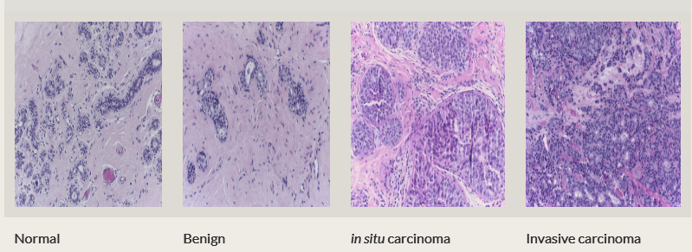
Breast Cancer Histology: BACH
400 images, 4 classes
14 GB
https://zenodo.org/records/3632035
Notes:
wget -O iciar2018_bach.zip https://zenodo.org/records/3632035/files/ICIAR2018_BACH_Challenge.zip?download=1
BACH Dataset : Grand Challenge on Breast Cancer Histology
Normal: 100
Benign: 100
in situ carcinoma: 100
Invasive carcinoma: 100
(*) Aresta, Guilherme, et al. "BACH: Grand challenge on breast cancer histology images." Medical image analysis (2019).
(*) Araújo, Teresa, et al. "Classification of breast cancer histology images using convolutional neural networks." PloS one 12.6 (2017): e0177544.
(*) Fondón, Irene, et al. "Automatic classification of tissue malignancy for breast carcinoma diagnosis." Computers in biology and medicine 96 (2018): 41-51.
https://zenodo.org/records/3632035
https://zenodo.org/records/3632035/files/ICIAR2018_BACH_Challenge.zip?download=1
https://iciar2018-challenge.grand-challenge.org/Dataset/

Slide 14
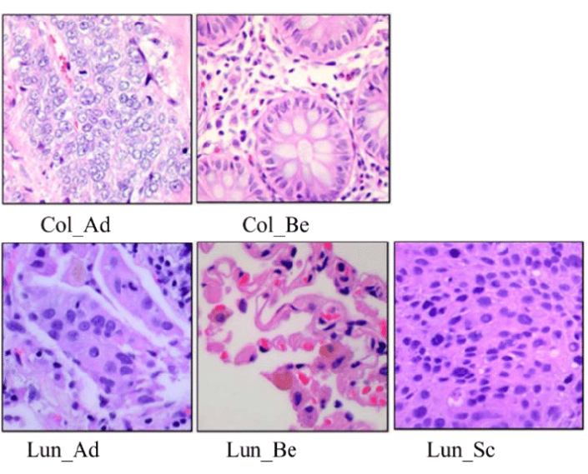
Lung and Colon: LC25000
25000 images with 5 classes
Colon adenocarcinoma, benign colon, lung adenocarcinoma, lung suqamous cell carcinoma, benign lung with 5k each
768x768 in JPEG format
1.89 GB
https://github.com/tampapath/lung_colon_image_set?tab=readme-ov-file
Notes:
wget -O LC25k.zip https://huggingface.co/datasets/NYCU-PCSxNTHU-MIS/LC25k/resolve/main/LC25000.zip?download=true
Borkowski AA, Bui MM, Thomas LB, Wilson CP, DeLand LA, Mastorides SM. Lung and Colon Cancer Histopathological Image Dataset (LC25000). arXiv:1912.12142v1 [eess.IV], 2019
https://academictorrents.com/details/7a638ed187a6180fd6e464b3666a6ea0499af4af

Slide 15
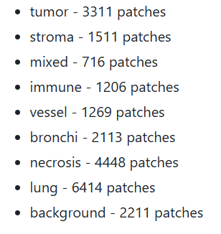
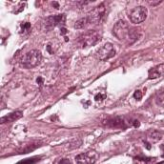
Lung Cancer Tissue Patches: LubLung
Lung
172x172 jpg images
200 MB
https://github.com/animgoeth/LubLung/tree/main
Notes:
git clone git@github.com:animgoeth/LubLung.git
cd LubLung
cat *.zip.* > lublung.zip
unzip lublung.zip
Deep learning-based tumor microenvironment segmentation is predictive of tumor mutations and patient survival in non-small-cell lung cancer

Slide 16
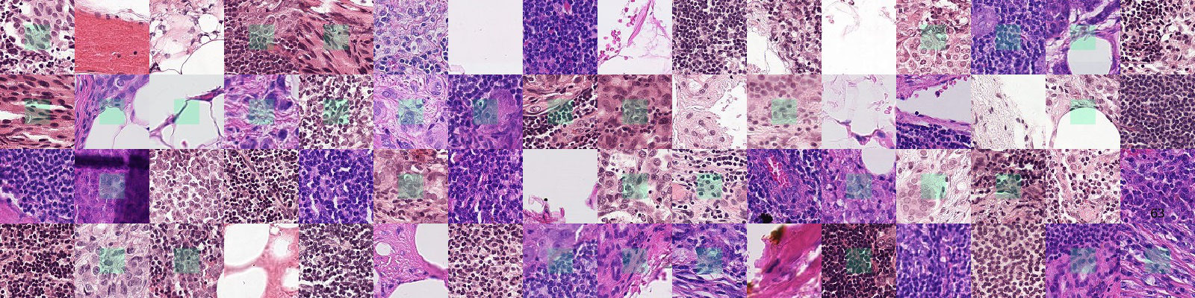
PatchCamelyon
327,680 histopathologic scans of lymph node sections
262,144 train, 32,768 for val/test
Binary classification
Positive: center 32x32 px region of patch contains at least one pixel of tumor (tumor tissue in outer region of patch does not influence label, enabled to design fully convolutional models without zero-padding, consistent behavior when applied to whole-slide image)
96x96, bigger than CIFAR10, smaller than ImageNet
10 GB
https://patchcamelyon.grand-challenge.org/Download/
Notes:
https://github.com/basveeling/pcam?tab=readme-ov-file
https://zenodo.org/records/2546921
https://drive.google.com/drive/folders/1gHou49cA1s5vua2V5L98Lt8TiWA3FrKB
[1] B. S. Veeling, J. Linmans, J. Winkens, T. Cohen, M. Welling. "Rotation Equivariant CNNs for Digital Pathology". arXiv:1806.03962
A citation of the original Camelyon16 dataset paper is appreciated as well:
[2] Ehteshami Bejnordi et al. Diagnostic Assessment of Deep Learning Algorithms for Detection of Lymph Node Metastases in Women With Breast Cancer. JAMA: The Journal of the American Medical Association, 318(22), 2199–2210. doi:jama.2017.14585
import gdown
def main():
gdown.download(
id='1qV65ZqZvWzuIVthK8eVDhIwrbnsJdbg_',
output='./camelyonpatch_level_2_split_test_x.h5.gz', quiet=False
)
gdown.download(
id='17BHrSrwWKjYsOgTMmoqrIjDy6Fa2o_gP',
output='./camelyonpatch_level_2_split_test_y.h5.gz', quiet=False
)
gdown.download(
id='1hgshYGWK8V-eGRy8LToWJJgDU_rXWVJ3',
output='./camelyonpatch_level_2_split_valid_x.h5.gz', quiet=False
)
gdown.download(
id='1bH8ZRbhSVAhScTS0p9-ZzGnX91cHT3uO',
output='./camelyonpatch_level_2_split_valid_y.h5.gz', quiet=False
)
gdown.download(
id='1Ka0XfEMiwgCYPdTI-vv6eUElOBnKFKQ2',
output='./camelyonpatch_level_2_split_train_x.h5.gz', quiet=False
)
gdown.download(
id='1269yhu3pZDP8UYFQs-NYs3FPwuK-nGSG',
output='./camelyonpatch_level_2_split_train_y.h5.gz', quiet=False
)
return 0
if __name__ == '__main__':
main()
python download_gdrive_patch_camelyon.py
gzip -d camelyonpatch_level_2_split_train_x.h5.gz
gzip -d camelyonpatch_level_2_split_train_y.h5.gz
gzip -d camelyonpatch_level_2_split_valid_x.h5.gz
gzip -d camelyonpatch_level_2_split_valid_y.h5.gz
gzip -d camelyonpatch_level_2_split_test_x.h5.gz
gzip -d camelyonpatch_level_2_split_test_y.h5.gz

Slide 17
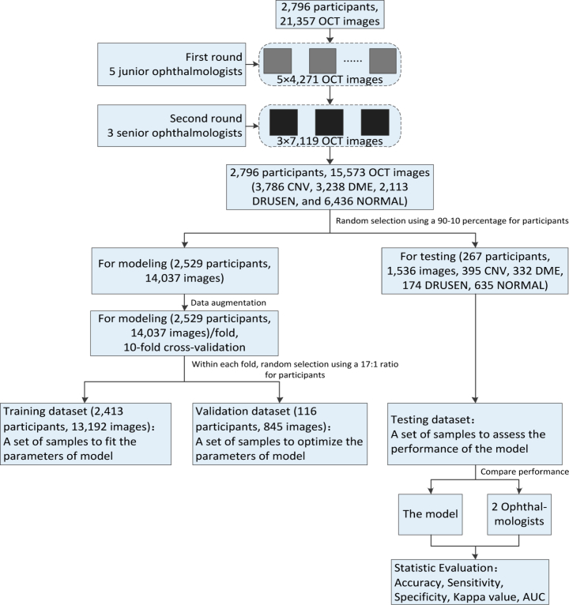
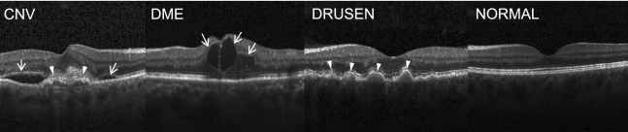
Optical Coherence Tomography: Shanghai OCT
108,309 train images
CNV: 37,205
DME: 11,348
Drusen: 8,616
Normal: 51,140
4,686 patients
1000 val (250 each)
6.55 GB
https://data.mendeley.com/datasets/rscbjbr9sj/3
Notes:
wget -O OCTXRay.zip https://data.mendeley.com/public-files/datasets/rscbjbr9sj/files/810b2ce2-11c3-4424-996e-3bef36600907/file_downloaded
Version 3: one download only
https://data.mendeley.com/public-files/datasets/rscbjbr9sj/files/810b2ce2-11c3-4424-996e-3bef36600907/file_downloaded
Version 2: provides separate downloads for OCT, ChestXray and code (6.55 GB in total)
https://data.mendeley.com/datasets/rscbjbr9sj/2
All data: X-ray and OCT
Xray:
https://data.mendeley.com/public-files/datasets/rscbjbr9sj/files/f12eaf6d-6023-432f-acc9-80c9d7393433/file_downloaded
OCT:
https://data.mendeley.com/public-files/datasets/rscbjbr9sj/files/5699a1d8-d1b6-45db-bb92-b61051445347/file_downloaded
Labeled Optical Coherence Tomography (OCT) and Chest X-Ray Images for Classification
Identifying Medical Diagnoses and Treatable Diseases by Image-Based Deep Learning
Deep learning-based classification and referral of treatable human diseases
Dataset of validated OCT and Chest X-Ray images described and analyzed in "Deep learning-based classification and referral of treatable human diseases". The OCT Images are split into a training set and a testing set of independent patients. OCT Images are labeled as (disease)-(randomized patient ID)-(image number by this patient) and split into 4 directories: CNV, DME, DRUSEN, and NORMAL.
We conducted a retrospective study and collected a total of 21,357 retinal OCT images from 2,796 adult patients from the Shanghai Zhongshan Hospital and the Shanghai First People’s Hospital between 2014 and 2019. All images were deidentified to protect the privacy and security of patients’ health information prior to transfer to study investigators. These OCT images were used for the development and evaluation of the deep learning approach based on improved ResNet50. These OCT images were acquired with Heidelberg SD-OCT imaging systems (Spectralis software version 6.0a; Heidelberg spectralis, Heidelberg Engineering, Heidelberg, Germany). The baseline scan protocol consisted of: scan extent = volume scan (15°× 5°); scan sections = B-scans; 7 sections; and OCT automatic real time (ART) averaging, where ART was set to 20, which suggested that 20 SD-OCT images were averaged. This methodology obtained non-contact, cross-section frames in high resolution of the retina. Besides, we also retrospectively collected a short medical history of the patients like age, personal record of retinal disease, and personal retinal disorder related therapy. This study adhered to the tenets of the Declaration of Helsinki, and approved by the local ethics committee. Due to the anonymous and retrospective nature of this work, a waiver of informed consent was provided.
Prior to training the deep learning models, all OCT images were read and assessed by ophthalmologists, and graded for the present of CNV, DME, DRUSEN, and NORMAL. The gold standard annotation (image labeling) was performed by ophthalmologists. The current study invited 8 ophthalmologists to grade 21,357 OCT images. All images were reviewed masking other clinical information, and each ophthalmologist made a diagnosis independent to other ophthalmologists. In the first round, we randomly assigned these images to 5 junior ophthalmologists for screening and labeling, each of which reviewed about 4,271 OCT images. In the second round, 3 senior ophthalmologists were invited to verify and correct the labelling results, each of which reviewed about 7,119 OCT images. Senior ophthalmologists had approximately 10 to 15 years of experience, and junior ophthalmologists had up to 5 years of experience. The grading was performed on full-screen, high-resolution 27-in monitors. OCT images with severe artifacts causing misalignment and blurring of sections or significant image resolution reductions were removed directly. Only images with a clear consensus annotation between ophthalmologists were taken into the sample and imported into the database. For disagreement in image labels, they were adjudicated by an expert committee composed of senior ophthalmologists. The dataset selection and stratification process were displayed in Fig. 2. Eventually, the retinal OCT dataset for the experiment consisted of 15,573 images, of which 3,786 were affected by CNV, 3,238 were assigned images with DME appearances, 2,113 were related to DRUSEN cases, and the others represented healthy cases. We randomly selected 267 patients and obtained 1,536 images (395 CNV, 332 DME, 174 DRUSEN, 635 NORMAL) as testing dataset. The 14,037 images of another 2,529 patients were used as training dataset and validation dataset. We fitted and optimized the parameters of model on the training dataset and validation dataset, respectively, while the performance of our model was evaluated on the testing dataset.
For the purpose of reflecting clinical care, increasing heterogeneity of OCT images within the training dataset, and reducing the possibility of overfitting, a data augmentation procedure was applied. Data augmentation can lead to better performing, more generalizable models which were invariant to certain types of image transformations and variations in image quality [26]. We first horizontally mirrored all images to mimic the inclusion of both oculus dexter (OD) and oculus sinister (OS) orientations of each image. Then, we applied a random cropping to all images including original and flipped images, and each cropped image was manually reviewed to ensure that each correctly retained pathological area. Through random cropping, the pathology areas of each image were randomly perturbed by a small amount, because the locations of these regions in the OCT images were not always identical in clinical care. The random cropping was repeated five times for each image. In total, 140,370 OCT images arising from (14,037 images) × (2 orientations) × (5 random crops) were obtained. We assigned each augmented image to the same label (CNV, DME, DRUSEN, and NORMAL) as the corresponding original input image. An example of input image and the corresponding augmentations was shown in Fig. 3. After augmentation, we used the Gaussian pyramid down sampling method [27] to establish a uniform size of 224 × 224 dimension for all images in the dataset as input to our model so that the computational requirements of our model could be satisfied.

Slide 18
Medical Datasets Others 2

Slide 19
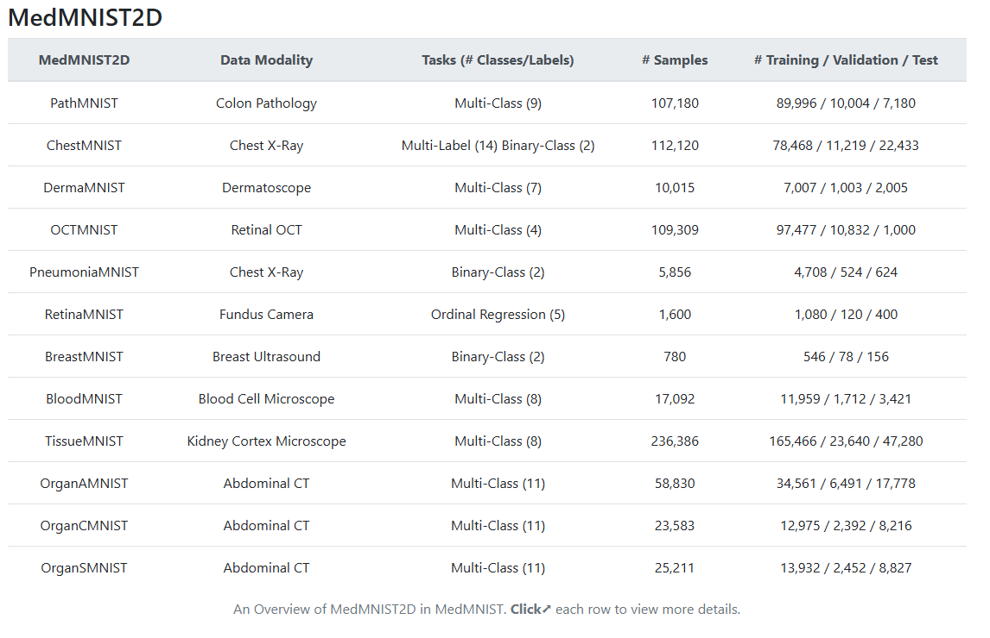
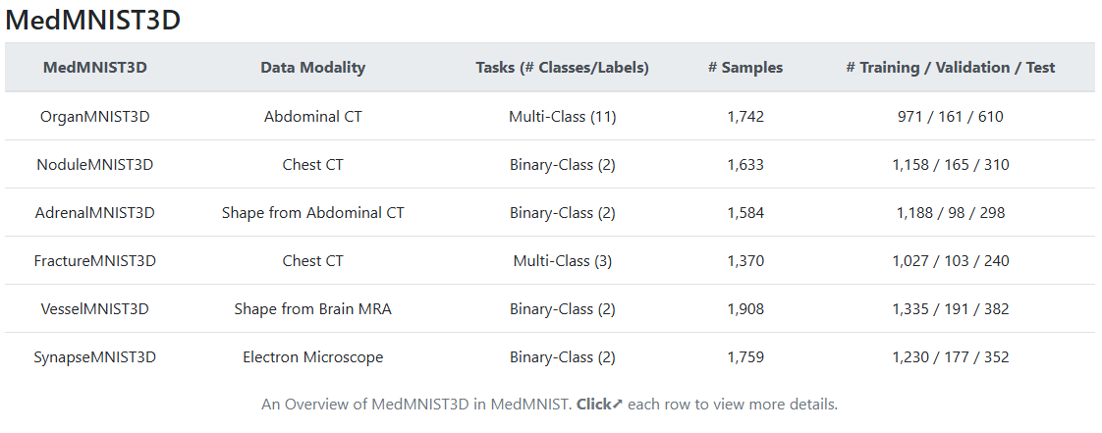
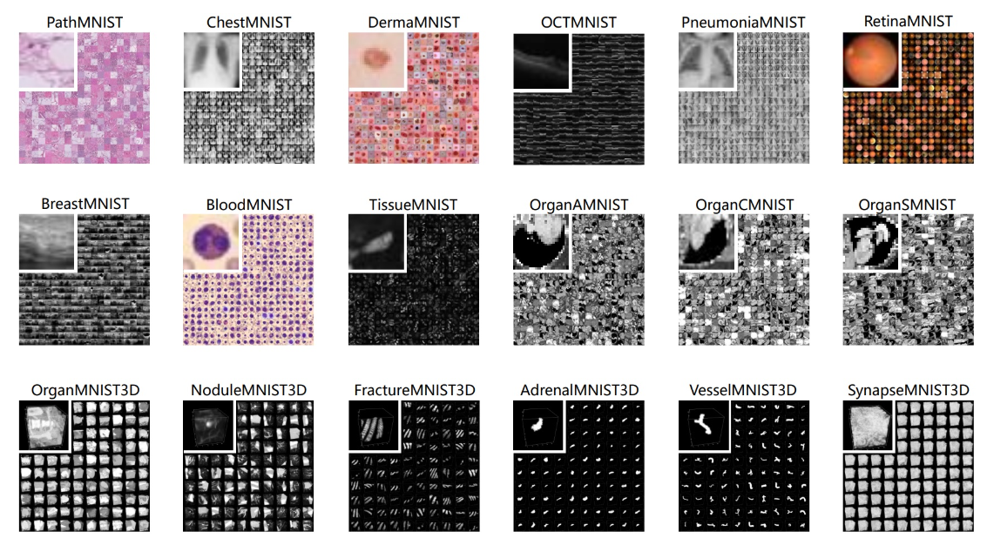
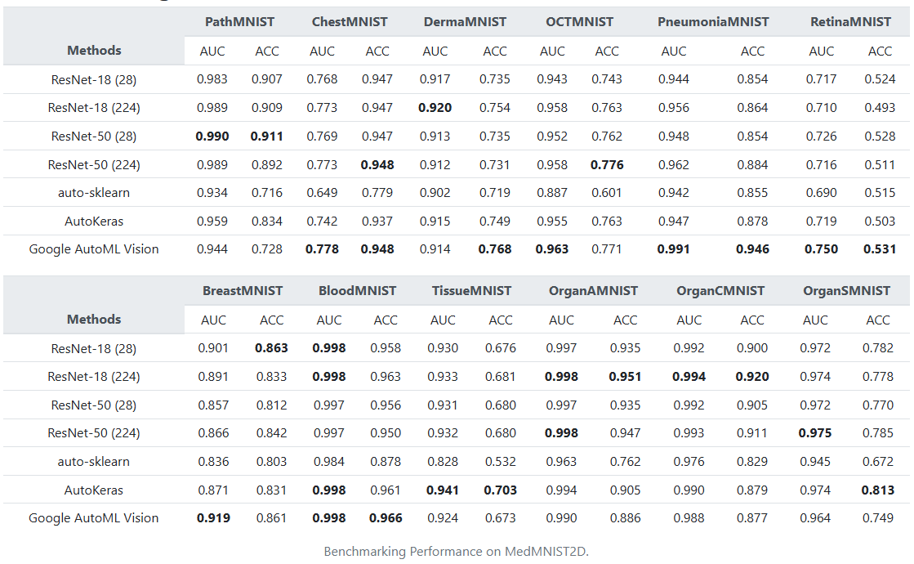
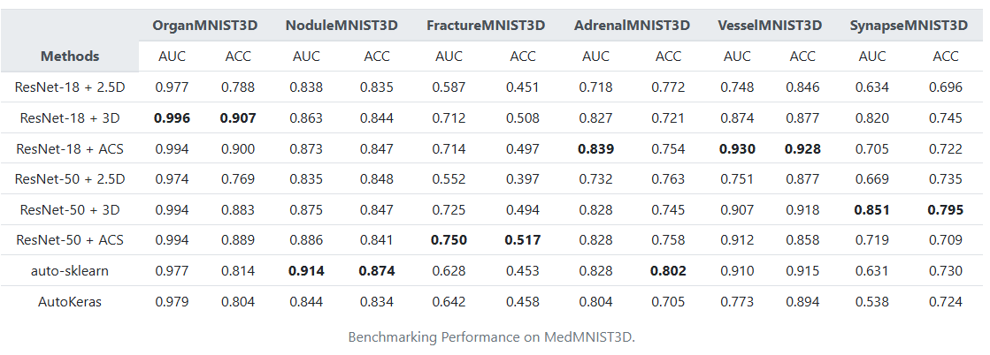
MedMNIST
https://medmnist.com/
MedMNIST Classification Decathlon: A Lightweight AutoML Benchmark for Medical Image Analysis. Yang JC / Ni BB. Shanghai Jiao Tong U, CN. ISBI 23.
MedMNIST v2 - A large-scale lightweight benchmark for 2D and 3D biomedical image classification. Yang JC / Ni BB. Shanghai Jiao Tong U, CN. Scientific Data 23.
Notes:
18x Standardized Datasets for 2D and 3D Biomedical Image Classification
with Multiple Size Options: 28 (MNIST-Like), 64, 128, and 224
MedMNIST is designed to perform classification on lightweight 2D and 3D images with various data scales (from 100 to 100,000) and diverse tasks (binary/multi-class, ordinal regression and multi-label). The resulting dataset, consisting of approximately 708K 2D images and 10K 3D images in total, could support numerous research and educational purposes in biomedical image analysis, computer vision and machine learning. We benchmark several baseline methods on MedMNIST, including 2D / 3D neural networks and open-source / commercial AutoML tools.
e MedMNIST+ with larger sizes: 64x64, 128x128, and 224x224 for 2D, and 64x64x64 for 3D. As a complement to the previous 28-size MedMNIST, the large-size version could serve as a standardized benchmark for medical foundation models.
https://www.kaggle.com/competitions/tensor-reloaded-multi-task-med-mnist
includes AUC metric for multi-class and binary-class
https://github.com/MedMNIST/MedMNIST/blob/main/medmnist/evaluator.py

Slide 20
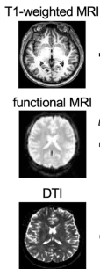
Taiwan Mental Illness: TAMI
Structural MRI, Functional MRI, and DTI
1265: 587 healthy and 678 patients (schizophrenia, bipolar disorder, depression)
https://data.dmc.nycu.edu.tw/zh_Hans_CN/dataset/taiwan-aging-and-mental-illness-cohort-tami
Notes:
Taiwan Aging and Mental Illness Cohort
(Diffusion Tensor Tractography)
he trained models were applied to the HC, SCZ, BT-HC, and BT-SCZ datasets to estimate brain ages and calculate brain-age gaps
To understand the neurological impacts of aging and mental illnesses.
To explore the structural and functional brain changes associated with schizophrenia, bipolar disorder, and depression. Additional Data:
Along with the MRI scans, the dataset also contains:
Demographic information of participants. Detailed clinical data for each participant.

Slide 21
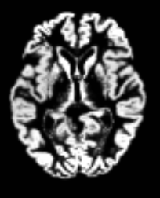
Alzheimer's Disease (AD): ADNI
Structural MRI?
Not clear what kind and amount of data and task
https://adni.loni.usc.edu/
Notes:
Alzheimer's Disease Neuroimaging Initiative ADNI
The ADNI data set is a comprehensive and widely used collection of longitudinal clinical, imaging, genetic, and other biomarker data. It encompasses various data types, including structural, functional, and molecular brain imaging, biofluid biomarkers, cognitive assessments, genetic data, and demographic information.
https://www.kaggle.com/code/ahmedashrafahmed/alzheimers-dataset-4-class-adni-using-cnn-99-5

Slide 22
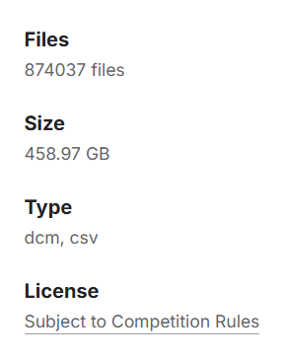
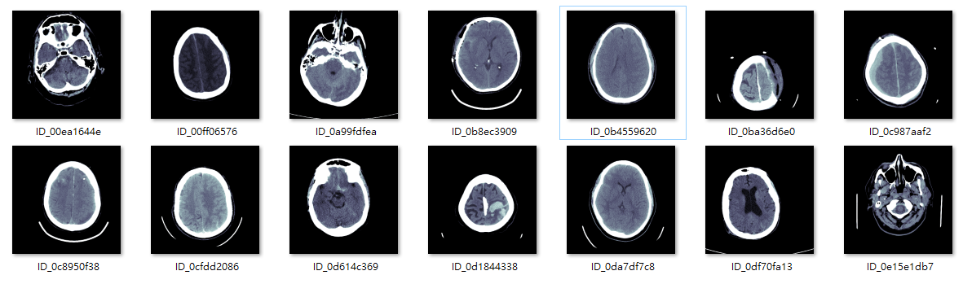
Intracranial Hemmorhage (ICA): RSNA
RSNA Intracranial Hemorrhage Detection Challenge (2019)
Computed tomography (CT)
Multi-class classification
459 GB
Notes:
Kaggle / RSNA Intracranial Hemorrhage Detection
all acute (i.e. new) hemorrhages appear dense (i.e. white) on computed tomography (CT), the primary imaging features that help Radiologists determine the subtype of hemorrhage are the location, shape and proximity to other structures (see table).
Huge size

Slide 23
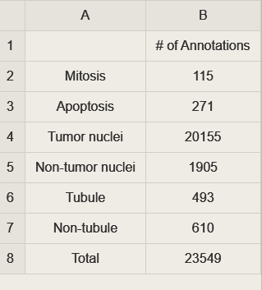
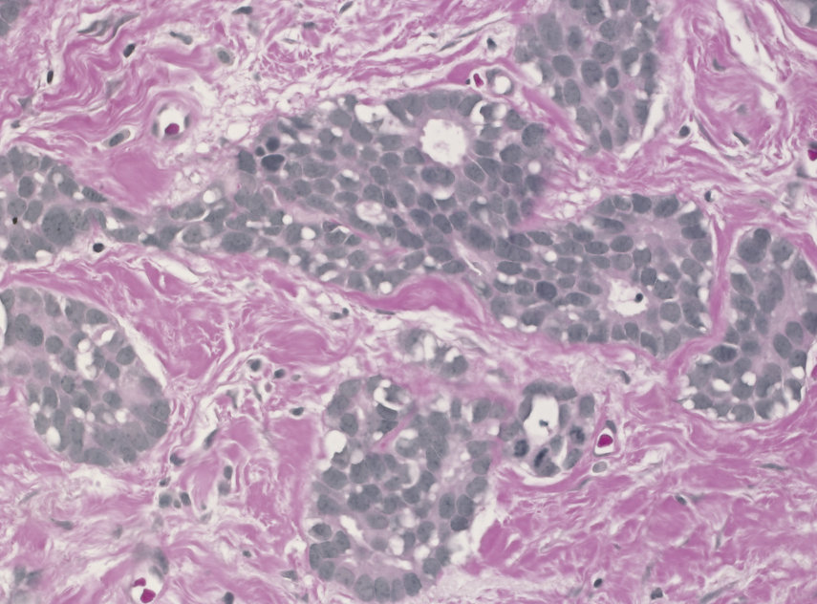
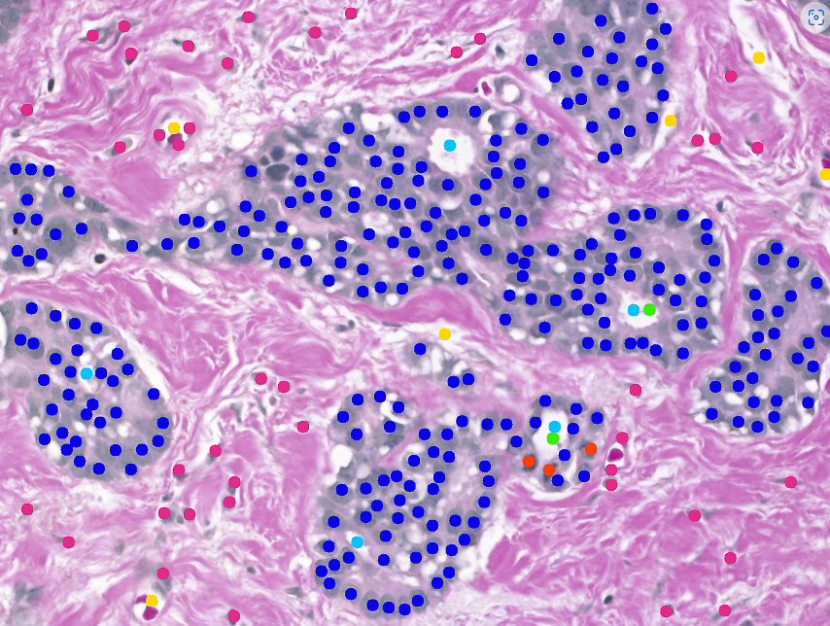
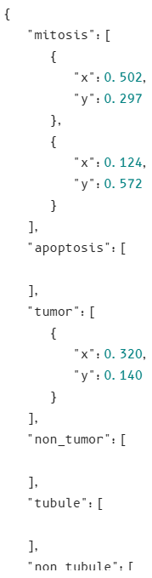
Breast Cancer Hystopathological: BreCaHAD
162 with 6 classes
Segmentation, keypoint localization
1 GB
https://figshare.com/articles/dataset/BreCaHAD_A_Dataset_for_Breast_Cancer_Histopathological_Annotation_and_Diagnosis/7379186
Notes:
BreCaHAD: A Dataset for Breast Cancer Histopathological Annotation and Diagnosis
https://figshare.com/ndownloader/articles/7379186/versions/3

Slide 24
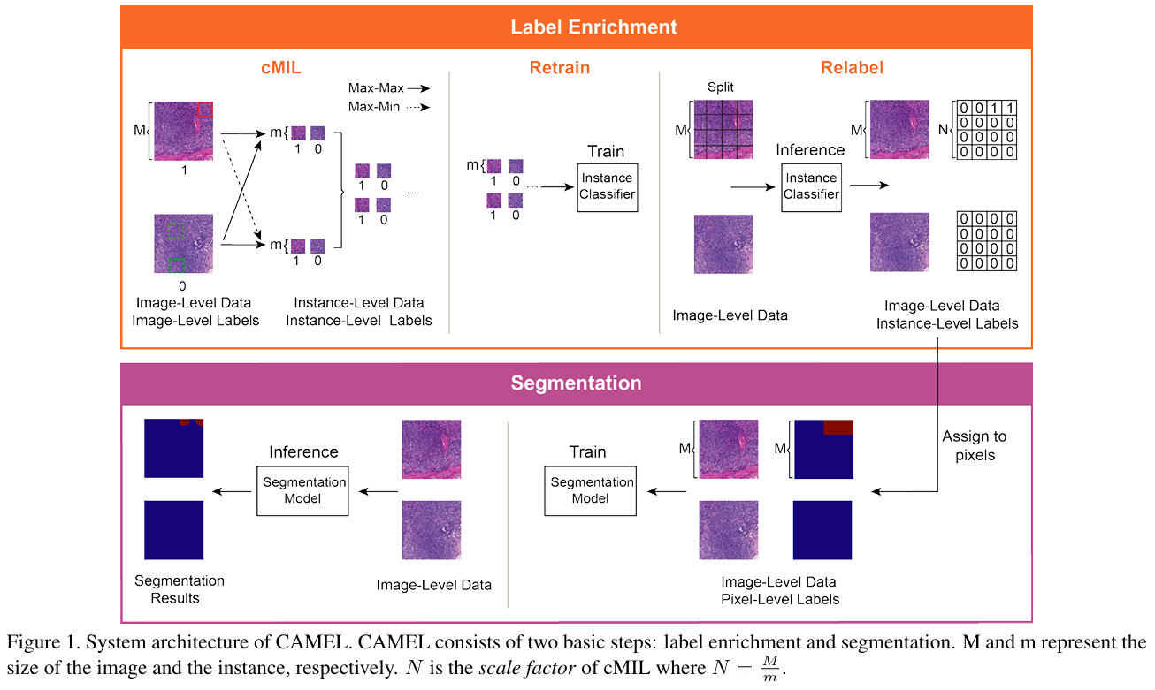
Colon Hystopathology: CAMEL
177 whole slide images (156 with adenoma)
Binary classification
Baidu Drive (cannot download?)
30 GB
https://github.com/ThoroughImages/CAMEL?tab=readme-ov-file
Notes:
CAMEL: A Weakly Supervised Learning Framework for Histopathology Image Segmentation. ICCV 19.
colorectal adenoma dataset

Slide 25
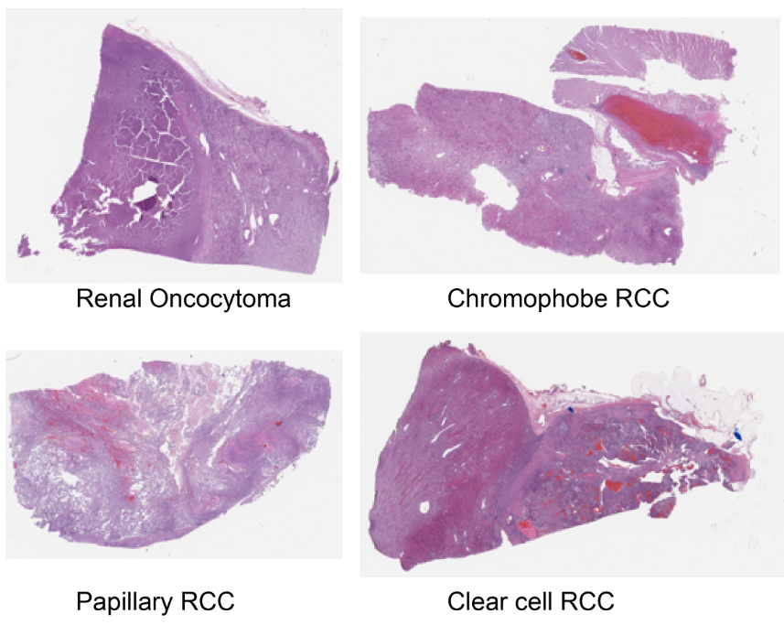
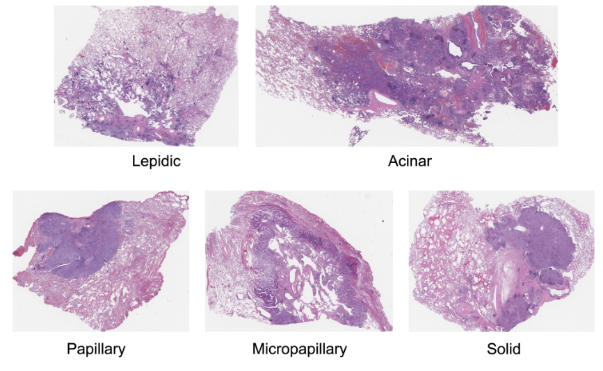
Kidney and Lung Cancer: DHMC-Kidney/Lung
563 and 143 WSI images
100/50 GB
https://bmirds.github.io/KidneyCancer/ https://bmirds.github.io/LungCancer/

Slide 26
Prostate Cancer: PANDA
10,616 train images, 393 valid, 545 internal test and 1071 external test
ISUP scale: severity of cancer on scale 0 to 5
Gleason score: more levels than ISUP scale
412 GB
https://www.kaggle.com/c/prostate-cancer-grade-assessment/data
Notes:
Prostate cANcer graDe Assessment (PANDA) Challenge

Slide 27
TissueNet
Epithelial lessions of uterine cervix of whole-slide images (WSI)
4 classes: benign, low malignant potential, high malignant potential, invasive cancer
700 GB with extremely high resolution (150k x 85k pixels)
https://www.drivendata.org/competitions/67/competition-cervical-biopsy/

Slide 28
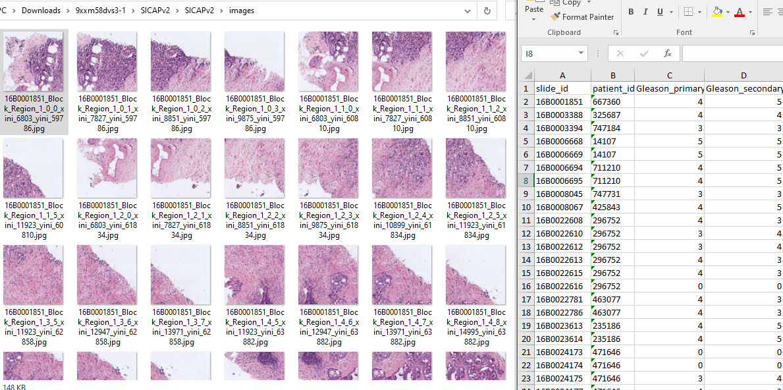
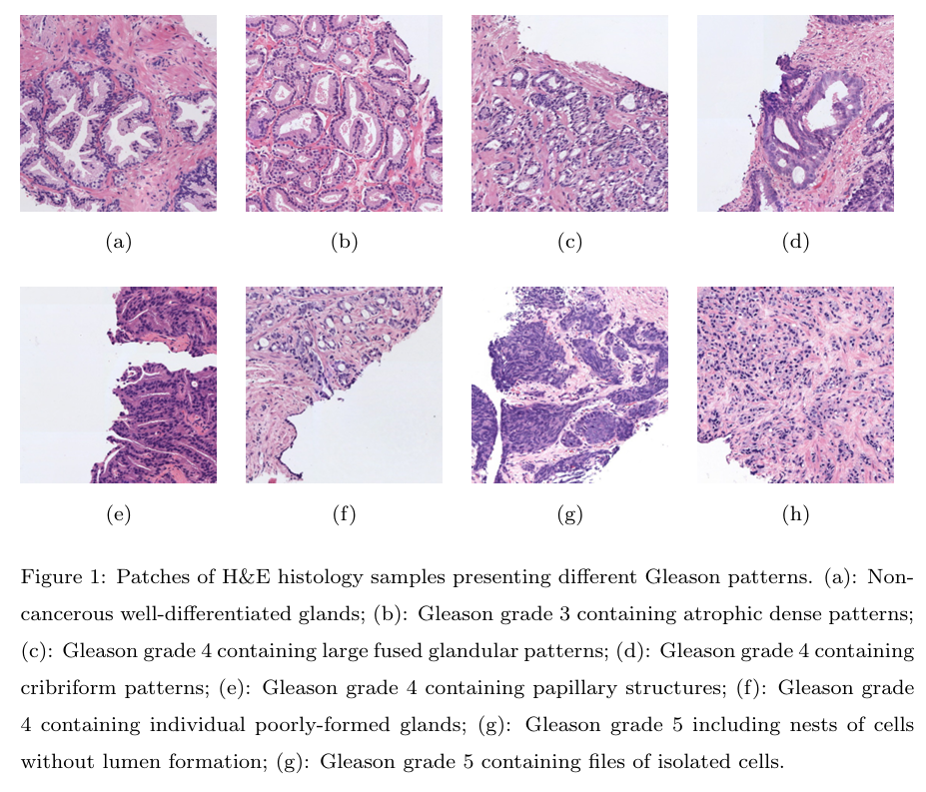
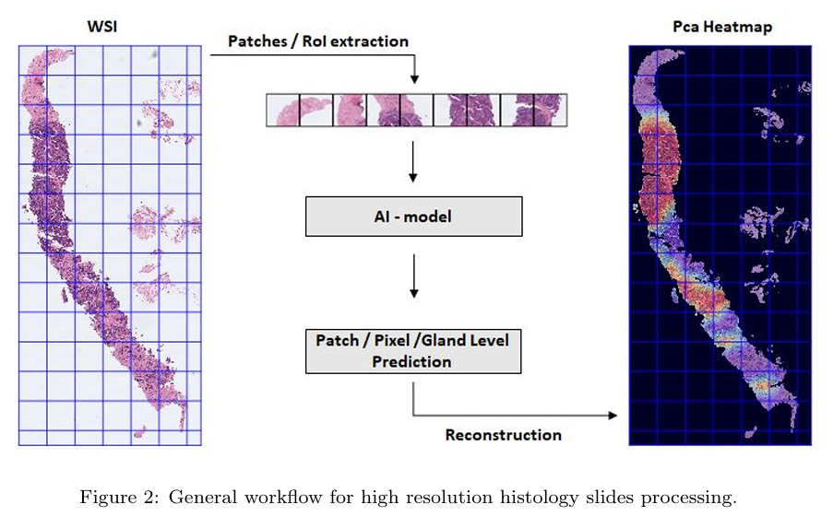
Prostate WSI: SICAPv2
155 from 95 patients
Global and patch-level Gleason scores
2 GB
https://data.mendeley.com/datasets/9xxm58dvs3/1
https://prod-dcd-datasets-cache-zipfiles.s3.eu-west-1.amazonaws.com/9xxm58dvs3-1.zip
Notes:
SICAPv2 - Prostate Whole Slide Images with Gleason Grades Annotations
Silva-Rodríguez, J., Colomer, A., Sales, M. A., Molina, R., & Naranjo, V. (2020). Going deeper through the Gleason scoring scale : An automatic end-to-end system for histology prostate grading and cribriform pattern detection. Computer Methods and Programs in Biomedicine, 195. https://doi.org/10.1016/j.cmpb.2020.105637

Slide 29
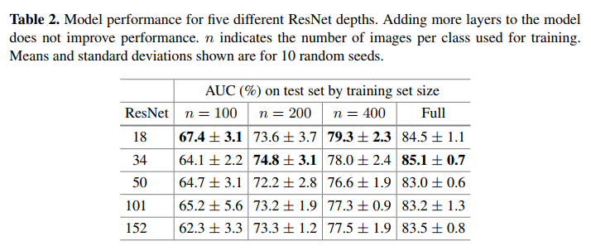
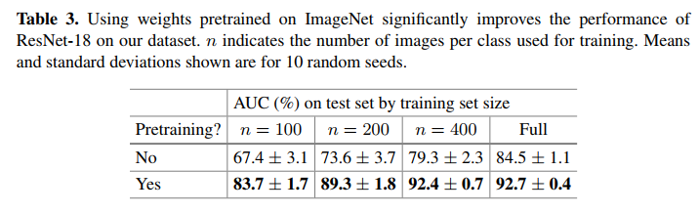
Colorectal Polyps: MHIST Results
Easy to overfit but transfer learning helps
A Petri Dish for Histopathology Image Analysis
Notes:
For our experiments, we follow the DeepSlide code repository [11] and use the ResNet architecture, a common choice for classifying histopathology images. Specifically, for our default baseline, we use ResNet-18 and train our model for 100 epochs (well past convergence) using stochastic data augmentation with the Adam optimizer [4], batch size of 32, initial learning rate of 1 × 10-3, and learning rate decay factor of 0.91
For more-robust evaluation, for each model we consider the five highest AUCs on the test set, which are evaluated at every epoch. We report the mean and standard deviation of these values calculated over 10 different random seeds.
Furthermore, we train our models with four different training set sizes: n = 100, n = 200, n = 400, and Full, where n is the number of training images per class and Full is the entire training set. To obtain subsets of the training set, we randomly sample n random images for each class from the training set for each seed. We keep our testing set fixed to ensure that models are evaluated equally.

Slide 30
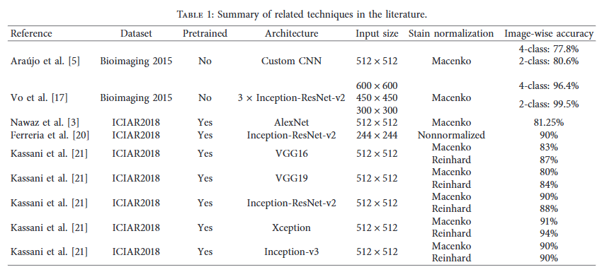
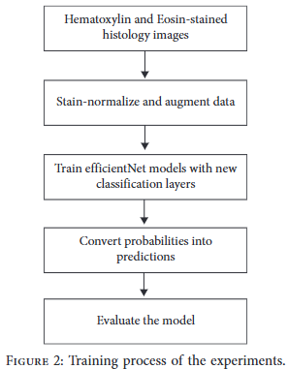
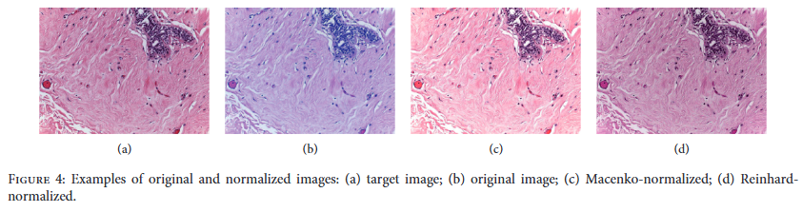
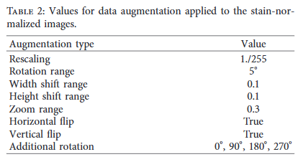
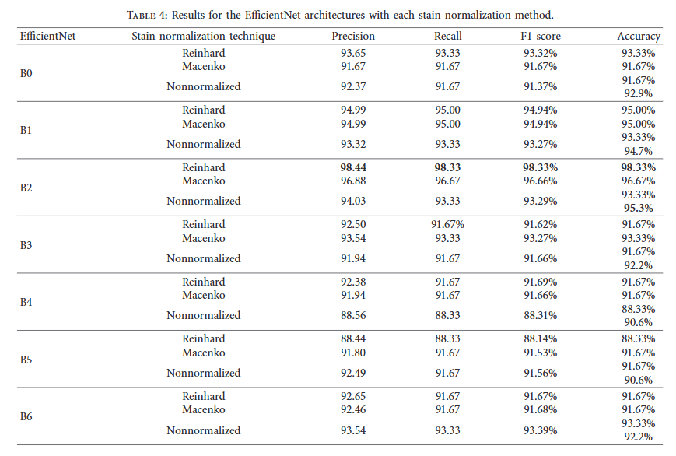
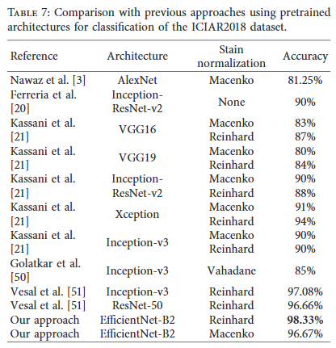
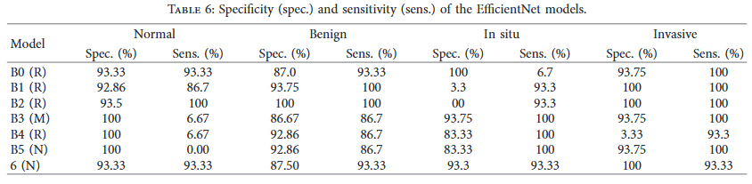
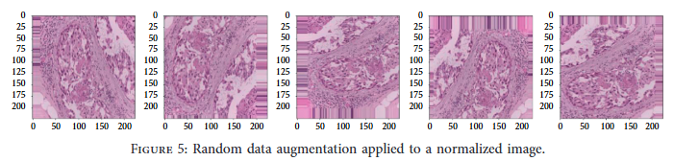
Breast Cancer Histology (BACH) Results
Normalized images and data augmentation
EfficientNet with transfer learning (only 3rd block onwards)
BACH Dataset : Grand Challenge on Breast Cancer Histology
Classification of Hematoxylin and Eosin-Stained Breast CancerHistology Microscopy Images Using TransferLearning with EfficientNets. Munien C / Viriri S. U of KwaZulu-Natal, SA. Computational Intelligence and Neuroscience.
Notes:
*e dataset was divided into train-test sets with split of85%–15%, as this split produced the highest results and hadless diﬃculty with overﬁtting.
Stain normalization of the images was ac-complished using a package provided by [46]
Keras, tensorflow, pretrained EfficientNet from ImageNet (also tried NoisyStudent weights but were not as good)
Each EﬃcientNet was extended with a global averagepooling layer, a dropout layer with a rate of 0.5, followed by adense layer of 256 neurons with the ReLU activationfunction, then another dropout layer with a rate of 0.4, andﬁnally a dense layer of 4 neurons with the softmax activationfunction.
AdamW, lr=1e-4, early stopping patience of 10 epochs, reduce LR on plateau after 8 epochs and minimum of 1e-6
Batch size 16 for B0-B4, 5 for B5 and B6
Train for 50 epochs
Frozen network with linear classifier did not perform well (domain gap)
Freezing early layers and only fine tune from third block onward (high-level features) and reuse low-level features from ImageNet
Table 6 provides additional insight by showing themodels’ sensitivity and speciﬁcity concerning each class. *eR, M, and N next to each model name refer to the stainnormalization method used on the dataset (Reinhard,Macenko, and nonnormalized). As previously mentioned,high sensitivity is crucial for this problem. It is a widely usedmetric to determine the proportion of correctly identiﬁed positives (as shown in (6)). As expected, the EﬃcientNet-B2model shows consistent high sensitivity throughout all fourclasses; however, it is less sensitive toward the in situ car-cinoma class. *e EﬃcientNet-B4 and -B5 return the lowestsensitivity to all four classes but especially to the non-carcinoma classes. *e sensitivity toward the carcinomaclass must be maximized, as an incorrect prediction of thistissue could lead to misdiagnosis and severe consequences.Aresta et al. [14] state that the benign class aﬀects theperformance of the networks due to the structural similaritywith normal tissue. *is class contains more morphologicalvariability than the others, which translates to increaseddiﬃculty in learning discriminative features. *is statementis consistent with the results reported in this study, as thebenign class typically returns the lowest sensitivity relative tothe other classes.

Slide 31
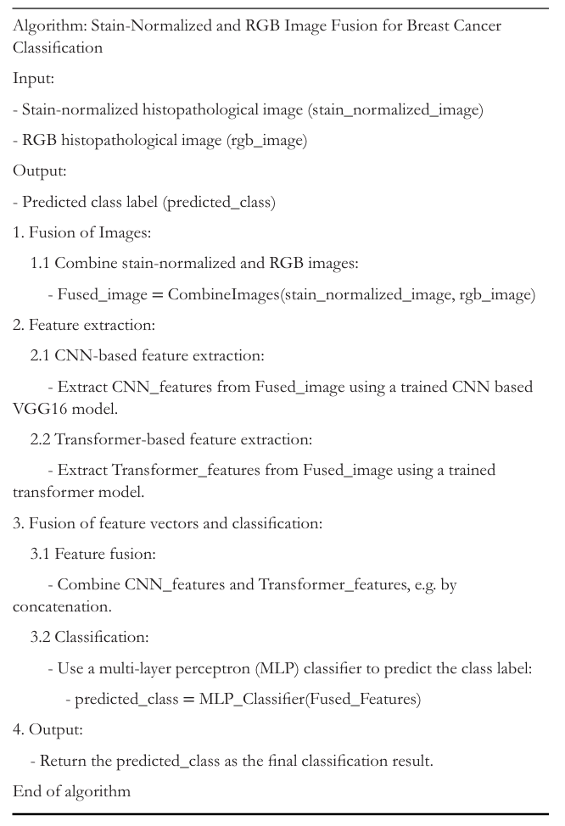
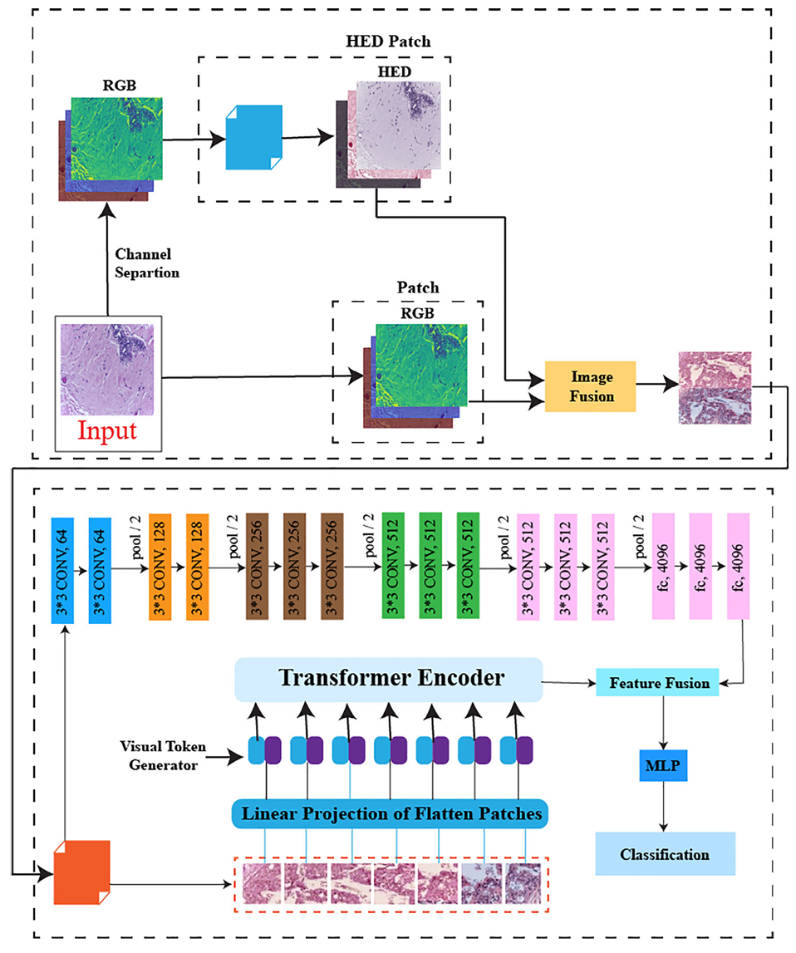
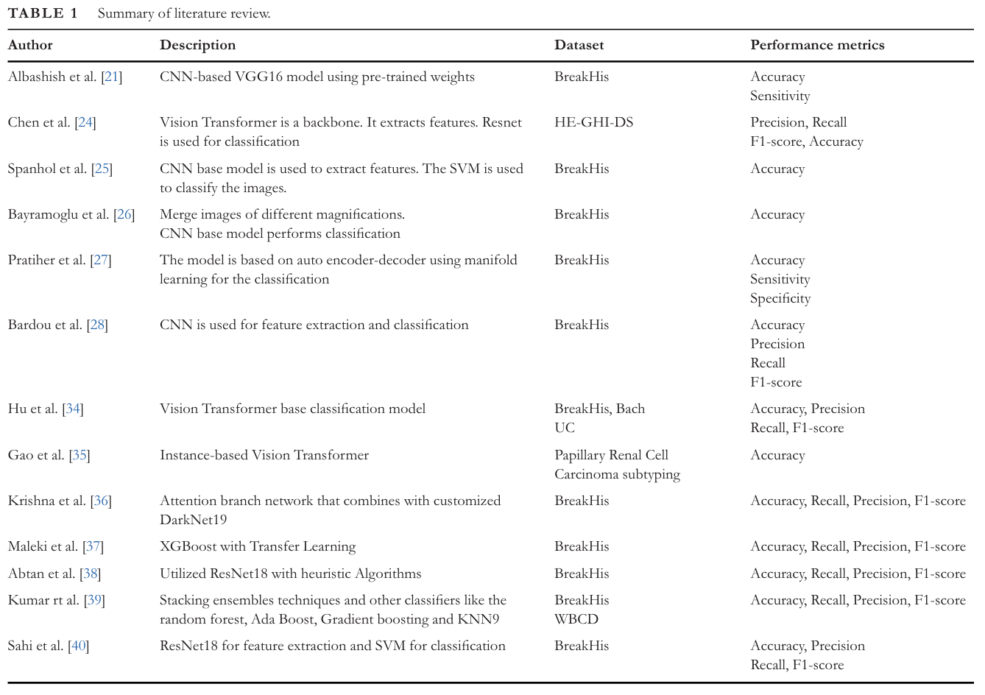
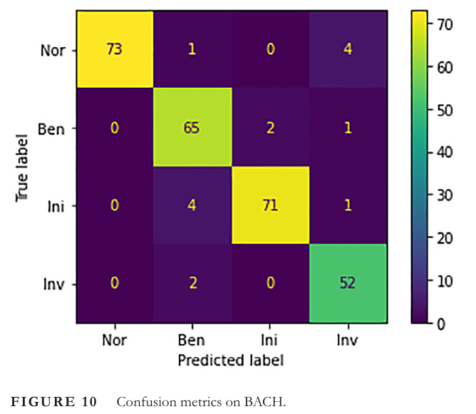

Breast Cancer Histology (BACH) Results
Stain normalization and fuse to RGB
CNN + ViT + MLP for predictions
BACH Dataset : Grand Challenge on Breast Cancer Histology
A deep fusion-based vision transformer for breast cancer classification. Fiaz A / Raza A. University Islamabad, PK. Healthcare Technology Letters 24.
Notes:
Image fusion is a technique that involves concatenating two or more different colour scheme images to create a composite image incorporating data from the original images. Histopathol ogy images contain stain properties, so we first need to perform a stain normalization process. Stain normalization changes image colours and brightness to a common standard. Stain normalization fixes this by changing histopathological images to a common colour style, making stains look the same in all images. It works by adjusting each image’s colours to match a standard reference. This helps machine learning models concentrate on disease-related traits instead of getting confused by staining differences. In short, stain normalization is crucial for reliable machine learning in medical diagnosis and research, preventing colour differences from affecting the accurate anal ysis of diseases. The effect of stain normalization is shown in Figure 2.
However, this change might cause us to lose important orig inal details, like slight staining differences that could help with diagnosis. Going too far with normalization might erase helpful features we need for careful examination. To mitigate this loss, we fuse the original image with the resultant image generated by the normalization technique, minimizing the loss of features.

Slide 32







ABIDE I Results
Identification of Novel Diagnostic Neuroimaging Biomarkers for Autism Spectrum Disorder Through Convolutional Neural Network-Based Analysis of Functional, Structural, and Diffusion Tensor Imaging Data Towards Enhanced Autism Diagnosis. arXiv 23
https://fcon_1000.projects.nitrc.org/indi/abide/abide_I.html
Notes:
The independent variables in the model consisted of neuroimaging features extracted from the various types of scans
A total of 1,111 samples was aggregated, drawing from an extensive array of 19 university study databases. For each subject, one fMRI scan, one sMRI scan, and one dMRI scan was collected.
A nearly equal amount of ASD and TC (521 and 590 respectively) samples were selected along with a nearly equal amount of male and female (557 and 554 respectively) samples, resulting in a representative selection of subjects

Slide 33

Gleason Score
Two grades (Gleason grades) for two most predominant patterns in biopsy
https://www.pcf.org/about-prostate-cancer/diagnosis-staging-prostate-cancer/gleason-score-isup-grade/
Notes:
Gleason grade to the most predominant pattern in your biopsy and a second Gleason grade to the second most predominant pattern. For example: 3 + 4. The two grades will then be added together to determine your Gleason score. Theoretically, Gleason scores range from 2-10. However, since Dr. Gleason’s original classification, pathologists almost never assign scores 2-5, and Gleason scores assigned will range from 6 to 10, with 6 being the lowest grade cancer.

